Slide 1
Introduction to Transaction Processing
Transaction: An executing program (process) that includes one or more database access operations
Read operations (database retrieval, such as SQL SELECT)
Write operations (modify database, such as SQL INSERT, UPDATE, DELETE)
Transaction: A logical unit of database processing
Example: Bank balance transfer of $100 dollars from a checking account to a saving account in a BANK database
Note: Each execution of a program is a distinct transaction with different parameters
Bank transfer program parameters: savings account number, checking account number, transfer amount

Slide 2
Introduction to Transaction Processing (cont.)
A transaction (set of operations) may be:
stand-alone, specified in a high-level language like SQL submitted interactively, or
consist of database operations embedded within a program (most transactions)
Transaction boundaries: Begin and End transaction.
Note: An application program may contain several transactions separated by Begin and End transaction boundaries

Slide 3
Introduction to Transaction Processing (cont.)
Transaction Processing Systems: Large multi-user database systems supporting thousands of concurrent transactions (user processes) per minute
Two Modes of Concurrency
Interleaved processing: concurrent execution of processes is interleaved in a single CPU
Parallel processing: processes are concurrently executed in multiple CPUs (Figure 21.1)
Basic transaction processing theory assumes interleaved concurrency

Slide 4
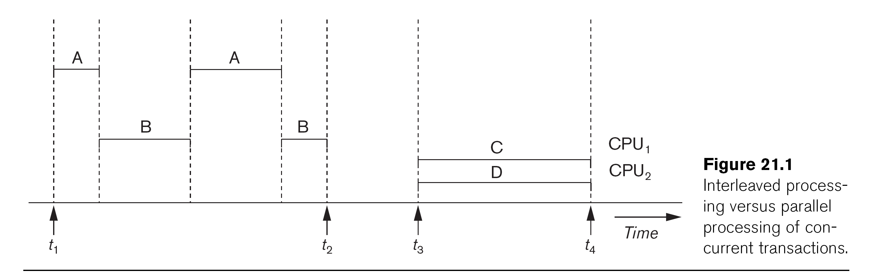

Slide 5
Introduction to Transaction Processing (cont.)
For transaction processing purposes, a simple database model is used:
A database - collection of named data items
Granularity (size) of a data item - a field (data item value), a record, or a whole disk block
TP concepts are independent of granularity
Basic operations on an item X:
read_item(X): Reads a database item named X into a program variable. To simplify our notation, we assume that the program variable is also named X.
write_item(X): Writes the value of program variable X into the database item named X.

Slide 6
Introduction to Transaction Processing (cont.)
READ AND WRITE OPERATIONS:
Basic unit of data transfer from the disk to the computer main memory is one disk block (or page). A data item X (what is read or written) will usually be the field of some record in the database, although it may be a larger unit such as a whole record or even a whole block.
read_item(X) command includes the following steps:
Find the address of the disk block that contains item X.
Copy that disk block into a buffer in main memory (if that disk block is not already in some main memory buffer).
Copy item X from the buffer to the program variable named X.

Slide 7
Introduction to Transaction Processing (cont.)
READ AND WRITE OPERATIONS (cont.):
write_item(X) command includes the following steps:
Find the address of the disk block that contains item X.
Copy that disk block into a buffer in main memory (if it is not already in some main memory buffer).
Copy item X from the program variable named X into its correct location in the buffer.
Store the updated block from the buffer back to disk (either immediately or at some later point in time).

Slide 8
Transaction Notation
Figure 21.2 (next slide) shows two examples of transactions
Notation focuses on the read and write operations
Can also write in shorthand notation:
T1: bi; r1(X); w1(X); r1(Y); w1(Y); ei;
T2: bi; r2(Y); w2(Y); ei;
bi and ei specify transaction boundaries (begin and end)
i specifies a unique transaction identifier (TId)

Slide 10
Transaction and System Concepts
A transaction is an atomic unit of work that is either completed in its entirety or not done at all. A transaction passes through several states (Figure 21.4, similar to process states in operating systems).
Transaction states:
Active state (executing read, write operations)
Partially committed state (ended but waiting for system checks to determine success or failure)
Committed state (transaction succeeded)
Failed state (transaction failed, must be rolled back)
Terminated State (transaction leaves system)

Slide 12
Transaction and System Concepts (cont.)
DBMS Recovery Manager needs system to keep track of the following operations (in the system log file):
begin_transaction: Start of transaction execution.
read or write: Read or write operations on the database items that are executed as part of a transaction.
end_transaction: Specifies end of read and write transaction operations have ended. System may still have to check whether the changes (writes) introduced by transaction can be permanently applied to the database (commit transaction); or whether the transaction has to be rolled back (abort transaction) because it violates concurrency control or for some other reason.

Slide 13
Transaction and System Concepts (cont.)
Recovery manager keeps track of the following operations (cont.):
commit_transaction: Signals successful end of transaction; any changes (writes) executed by transaction can be safely committed to the database and will not be undone.
abort_transaction (or rollback): Signals transaction has ended unsuccessfully; any changes or effects that the transaction may have applied to the database must be undone.

Slide 14
Transaction and System Concepts (cont.)
System operations used during recovery
undo(X): Similar to rollback except that it applies to a single write operation rather than to a whole transaction.
redo(X): This specifies that a write operation of a committed transaction must be redone to ensure that it has been applied permanently to the database on disk.

Slide 15
Transaction and System Concepts (cont.)
The System Log File
Is an append-only file to keep track of all operations of all transactions in the order in which they occurred. This information is needed during recovery from failures
Log is kept on disk - not affected except for disk or catastrophic failure
As with other disk files, a log main memory buffer is kept for holding the records being appended until the whole buffer is appended to the end of the log file on disk
Log is periodically backed up to archival storage (tape) to guard against catastrophic failures

Slide 16
Transaction and System Concepts (cont.)
Types of records (entries) in log file:
[start_transaction,T]: Records that transaction T has started execution.
[write_item,T,X,old_value,new_value]: T has changed the value of item X from old_value to new_value.
[read_item,T,X]: T has read the value of item X (not needed in many cases).
[end_transaction,T]: T has ended execution
[commit,T]: T has completed successfully, and committed.
[abort,T]: T has been aborted.

Slide 17
Transaction and System Concepts (cont.)
Commit Point of a Transaction:
Definition: A transaction T reaches its commit point when all its operations that access the database have been executed successfully and the effect of all the transaction operations on the database has been recorded in the log file (on disk). The transaction is then said to be committed.

Slide 18
Transaction and System Concepts (cont.)
Commit Point of a Transaction (cont.):
Log file buffers: Like database files on disk, whole disk blocks must be read or written to main memory buffers.
For log file, the last disk block (or blocks) of the file will be in main memory buffers to easily append log entries at end of file.
Force writing the log buffer: before a transaction reaches its commit point, any main memory buffers of the log that have not been written to disk yet must be copied to disk.
Called force-writing the log buffers before committing a transaction.
Needed to ensure that any write operations by the transaction are recorded in the log file on disk before the transaction commits

Slide 19
Desirable Properties of Transactions
Called ACID properties – Atomicity, Consistency, Isolation, Durability:
Atomicity: A transaction is an atomic unit of processing; it is either performed in its entirety or not performed at all.
Consistency preservation: A correct execution of the transaction must take the database from one consistent state to another.

Slide 20
Desirable Properties of Transactions (cont.)
ACID properties (cont.):
Isolation: Even though transactions are executing concurrently, they should appear to be executed in isolation – that is, their final effect should be as if each transaction was executed in isolation from start to finish.
Durability or permanency: Once a transaction is committed, its changes (writes) applied to the database must never be lost because of subsequent failure.

Slide 21
Desirable Properties of Transactions (cont.)
Atomicity: Enforced by the recovery protocol.
Consistency preservation: Specifies that each transaction does a correct action on the database on its own. Application programmers and DBMS constraint enforcement are responsible for this.
Isolation: Responsibility of the concurrency control protocol.
Durability or permanency: Enforced by the recovery protocol.

Slide 22
Schedules of Transactions
Transaction schedule (or history): When transactions are executing concurrently in an interleaved fashion, the order of execution of operations from the various transactions forms what is known as a transaction schedule (or history).
Figure 21.5 (next slide) shows 4 possible schedules (A, B, C, D) of two transactions T1 and T2:
Order of operations from top to bottom
Each schedule includes same operations
Different order of operations in each schedule

Slide 23
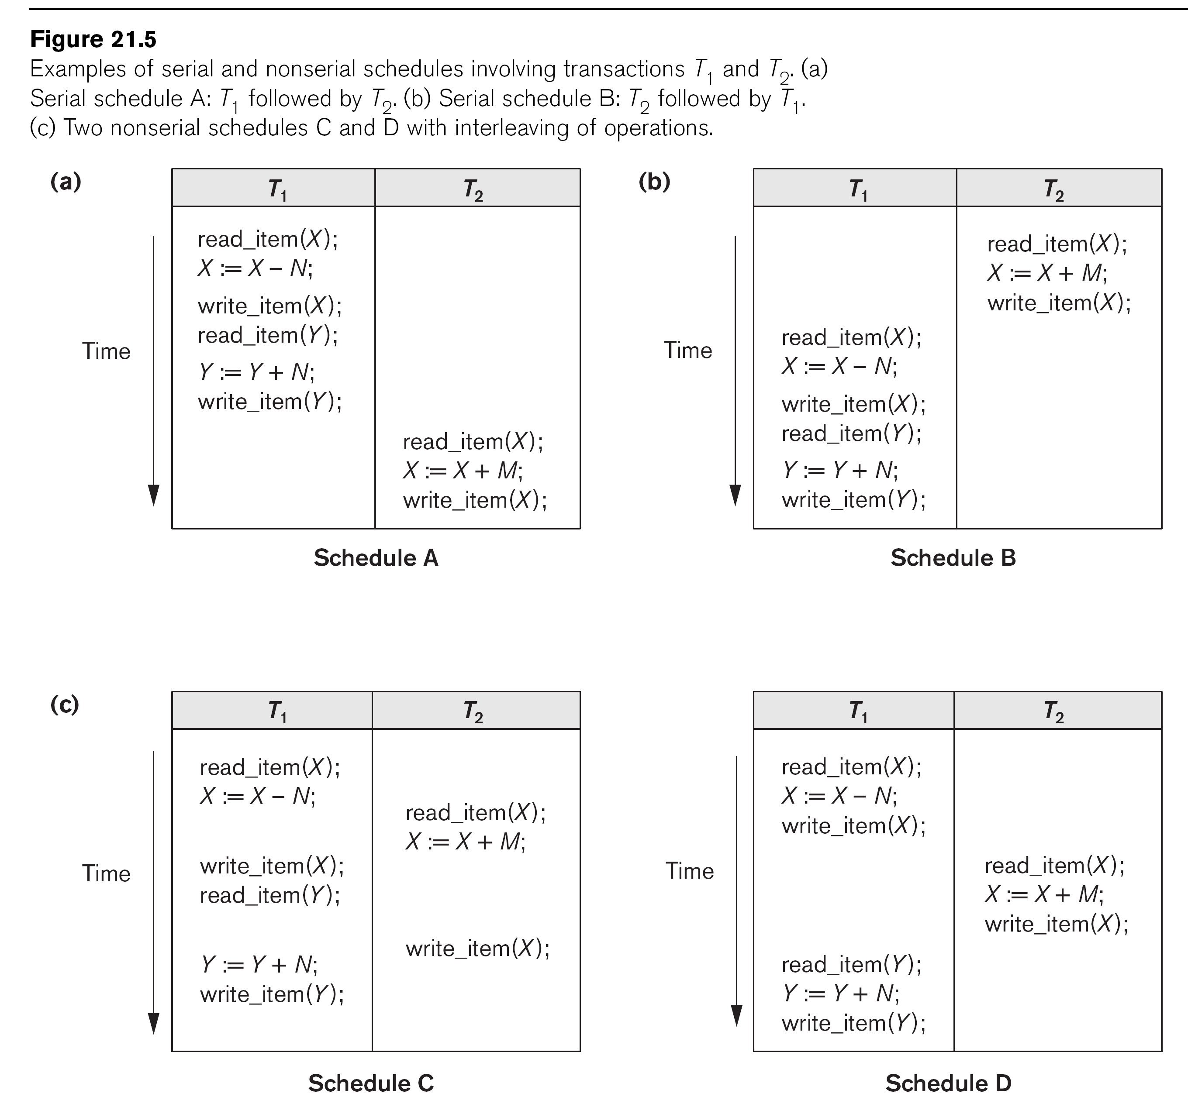

Slide 24
Schedules of Transactions (cont.)
Schedules can also be displayed in more compact notation
Order of operations from left to right
Include only read (r) and write (w) operations, with transaction id (1, 2, …) and item name (X, Y, …)
Can also include other operations such as b (begin), e (end), c (commit), a (abort)
Schedules in Figure 21.5 would be displayed as follows:
Schedule A: r1(X); w1(X); r1(Y); w1(Y); r2(X); w2(x);
Schedule B: r2(X); w2(X); r1(X); w1(X); r1(Y); w1(Y);
Schedule C: r1(X); r2(X); w1(X); r1(Y); w2(X); w1(Y);
Schedule D: r1(X); w1(X); r2(X); w2(X); r1(Y); w1(Y);

Slide 25
Schedules of Transactions (cont.)
Formal definition of a schedule (or history) S of n transactions T1, T2, ..., Tn :
An ordering of all the operations of the transactions subject to the constraint that, for each transaction Ti that participates in S, the operations of Ti in S must appear in the same order in which they occur in Ti.
Note: Operations from other transactions Tj can be interleaved with the operations of Ti in S.

Slide 26
Characterizing Schedules based on Recoverability
Schedules classified into two main classes:
Recoverable schedule: One where no committed transaction needs to be rolled back (aborted).
A schedule S is recoverable if no transaction T in S commits until all transactions T’ that have written an item that T reads have committed.
Non-recoverable schedule: A schedule where a committed transaction may have to be rolled back during recovery.
This violates Durability from ACID properties (a committed transaction cannot be rolled back) and so non-recoverable schedules should not be allowed.

Slide 27
Characterizing Schedules Based on Recoverability (cont.)
Example: Schedule A below is non-recoverable because T2 reads the value of X that was written by T1, but then T2 commits before T1 commits or aborts
To make it recoverable, the commit of T2 (c2) must be delayed until T1 either commits, or aborts (Schedule B)
If T1 commits, T2 can commit
If T1 aborts, T2 must also abort because it read a value that was written by T1; this value must be undone (reset to its old value) when T1 is aborted
known as cascading rollback
Schedule A: r1(X); w1(X); r2(X); w2(X); c2; r1(Y); w1(Y); c1 (or a1)
Schedule B: r1(X); w1(X); r2(X); w2(X); r1(Y); w1(Y); c1 (or a1); ...

Slide 28
Characterizing Schedules based on Recoverability (cont.)
Recoverable schedules can be further refined:
Cascadeless schedule: A schedule in which a transaction T2 cannot read an item X until the transaction T1 that last wrote X has committed.
The set of cascadeless schedules is a subset of the set of recoverable schedules.
Schedules requiring cascaded rollback: A schedule in which an uncommitted transaction T2 that read an item that was written by a failed transaction T1 must be rolled back.

Slide 29
Characterizing Schedules Based on Recoverability (cont.)
Example: Schedule B below is not cascadeless because T2 reads the value of X that was written by T1 before T1 commits
If T1 aborts (fails), T2 must also be aborted (rolled back) resulting in cascading rollback
To make it cascadeless, the r2(X) of T2 must be delayed until T1 commits (or aborts and rolls back the value of X to its previous value) – see Schedule C
Schedule B: r1(X); w1(X); r2(X); w2(X); r1(Y); w1(Y); c1 (or a1);
Schedule C: r1(X); w1(X); r1(Y); w1(Y); c1; r2(X); w2(X); ...

Slide 30
Characterizing Schedules based on Recoverability (cont.)
Cascadeless schedules can be further refined:
Strict schedule: A schedule in which a transaction T2 can neither read nor write an item X until the transaction T1 that last wrote X has committed.
The set of strict schedules is a subset of the set of cascadeless schedules.
If blind writes are not allowed, all cascadeless schedules are also strict
Blind write: A write operation w2(X) that is not preceded by a read r2(X).

Slide 31
Characterizing Schedules Based on Recoverability (cont.)
Example: Schedule C below is cascadeless and also strict (because it has no blind writes)
Schedule D is cascadeless, but not strict (because of the blind write w3(X), which writes the value of X before T1 commits)
To make it strict, w3(X) must be delayed until after T1 commits – see Schedule E
Schedule C: r1(X); w1(X); r1(Y); w1(Y); c1; r2(X); w2(X); …
Schedule D: r1(X); w1(X); w3(X); r1(Y); w1(Y); c1; r2(X); w2(X); …
Schedule E: r1(X); w1(X); r1(Y); w1(Y); c1; w3(X); r2(X); w2(X); …

Slide 32
Characterizing Schedules Based on Recoverability (cont.)
Summary:
Many schedules can exist for a set of transactions
The set of all possible schedules can be partitioned into two subsets: recoverable and non-recoverable
A subset of the recoverable schedules are cascadeless
If blind writes are allowed, a subset of the cascadeless schedules are strict
If blind writes are not allowed, the set of cascadeless schedules is the same as the set of strict schedules

Slide 33
Characterizing Schedules based on Serializability
Among the large set of possible schedules, we want to characterize which schedules are guaranteed to give a correct result
The consistency preservation property of the ACID properties states that: each transaction if executed on its own (from start to finish) will transform a consistent state of the database into another consistent state
Hence, each transaction is correct on its own

Slide 34
Characterizing Schedules based on Serializability (cont.)
Serial schedule: A schedule S is serial if, for every transaction T participating in the schedule, all the operations of T are executed consecutively (without interleaving of operations from other transactions) in the schedule. Otherwise, the schedule is called nonserial.
Based on the consistency preservation property, any serial schedule will produce a correct result (assuming no inter-dependencies among different transactions)

Slide 35
Characterizing Schedules based on Serializability (cont.)
Serial schedules are not feasible for performance reasons:
No interleaving of operations
Long transactions force other transactions to wait
System cannot switch to other transaction when a transaction is waiting for disk I/O or any other event
Need to allow concurrency with interleaving without sacrificing correctness

Slide 36
Characterizing Schedules based on Serializability (cont.)
Serializable schedule: A schedule S is serializable if it is equivalent to some serial schedule of the same n transactions.
There are (n)! serial schedules for n transactions – a serializable schedule can be equivalent to any of the serial schedules
Question: How do we define equivalence of schedules?

Slide 37
Equivalence of Schedules
Result equivalent: Two schedules are called result equivalent if they produce the same final state of the database.
Difficult to determine without analyzing the internal operations of the transactions, which is not feasible in general.
May also get result equivalence by chance for a particular input parameter even though schedules are not equivalent in general (see Figure 21.6, next slide)

Slide 39
Equivalence of Schedules (cont.)
Conflict equivalent: Two schedules are conflict equivalent if the relative order of any two conflicting operations is the same in both schedules.
Commonly used definition of schedule equivalence
Two operations are conflicting if:
They access the same data item X
They are from two different transactions
At least one is a write operation
Read-Write conflict example: r1(X) and w2(X)
Write-write conflict example: w1(Y) and w2(Y)

Slide 40
Equivalence of Schedules (cont.)
Changing the order of conflicting operations generally causes a different outcome
Example: changing r1(X); w2(X) to w2(X); r1(X) means that T1 will read a different value for X
Example: changing w1(Y); w2(Y) to w2(Y); w1(Y) means that the final value for Y in the database can be different
Note that read operations are not conflicting; changing r1(Z); r2(Z) to r2(Z); r1(Z) does not change the outcome

Slide 41
Characterizing Scedules Based on Serializability (cont.)
Conflict equivalence of schedules is used to determine which schedules are correct in general (serializable)
A schedule S is said to be serializable if it is conflict equivalent to some serial schedule S’.

Slide 42
Characterizing Schedules based on Serializability (cont.)
A serializable schedule is considered to be correct because it is equivalent to a serial schedule, and any serial schedule is considered to be correct
It will leave the database in a consistent state.
The interleaving is appropriate and will result in a state as if the transactions were serially executed, yet will achieve efficiency due to concurrent execution and interleaving of operations from different transactions.

Slide 43
Characterizing Schedules based on Serializability (cont.)
Serializability is generally hard to check at run-time:
Interleaving of operations is generally handled by the operating system through the process scheduler
Difficult to determine beforehand how the operations in a schedule will be interleaved
Transactions are continuously started and terminated

Slide 44
Characterizing Schedules Based on Serializability (cont.)
Practical approach:
Come up with methods (concurrency control protocols) to ensure serializability (discussed in Chapter 22)
DBMS concurrency control subsystem will enforce the protocol rules and thus guarantee serializability of schedules
Current approach used in most DBMSs:
Use of locks with two phase locking (see Section 22.1)

Slide 45
Characterizing Schedules based on Serializability (cont.)
Testing for conflict serializability
Algorithm 21.1:
Looks at only r(X) and w(X) operations in a schedule
Constructs a precedence graph (serialization graph) – one node for each transaction, plus directed edges
An edge is created from T_{i} to T_{j} if one of the operations in T_{i} appears before a conflicting operation in T_{j}
The schedule is serializable if and only if the precedence graph has no cycles.

Slide 46
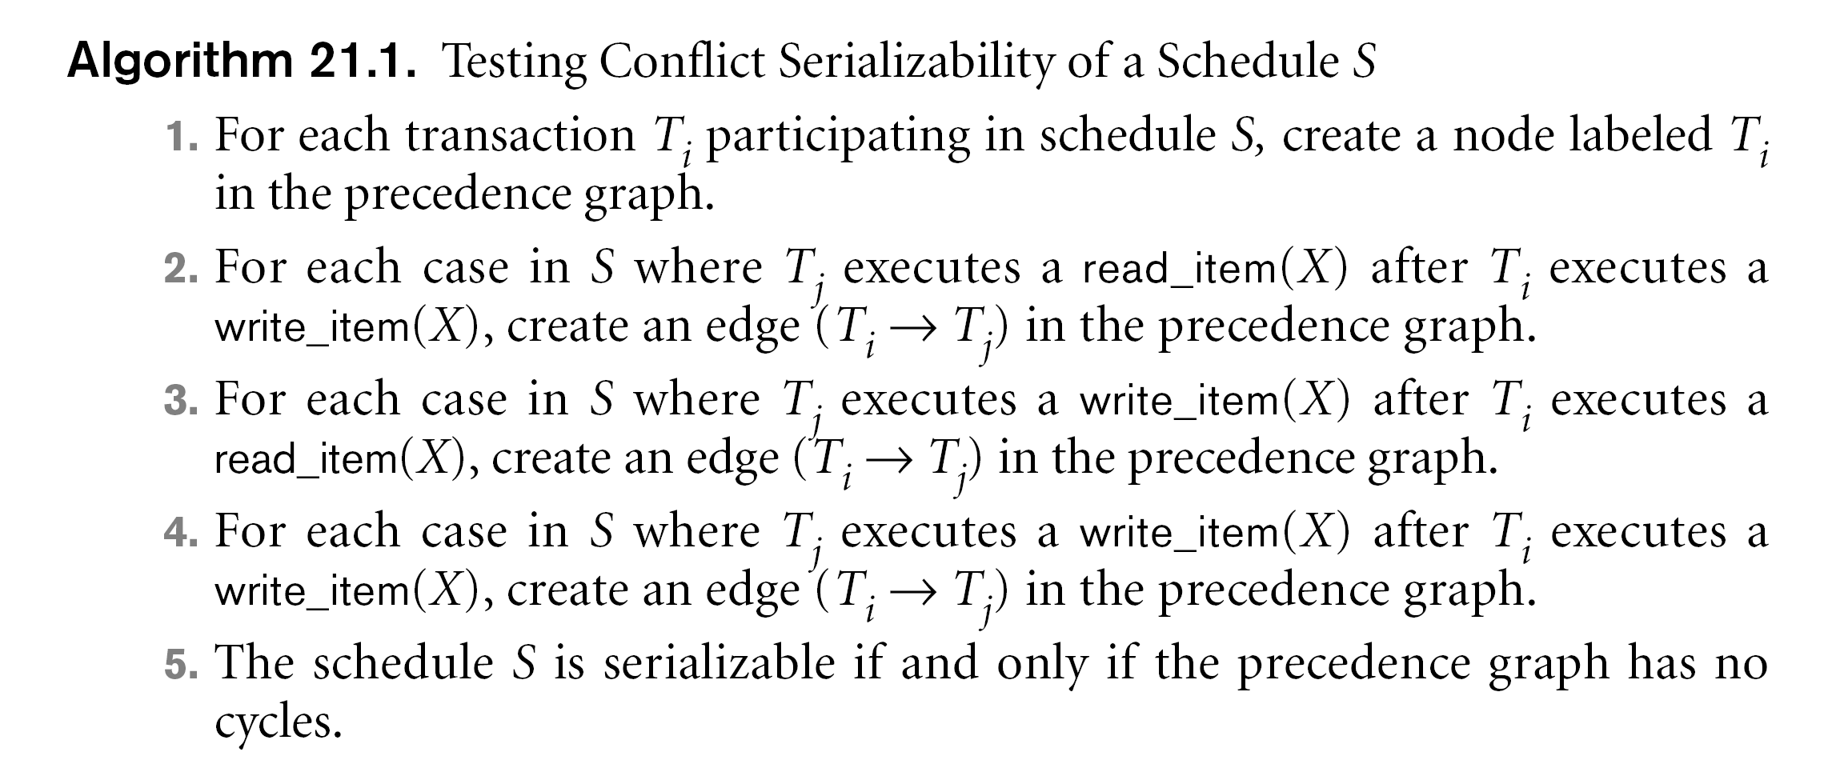

Slide 50
Characterizing Schedules based on Serializability (cont.)
View equivalence: A less restrictive definition of equivalence of schedules than conflict serializability when blind writes are allowed
View serializability: definition of serializability based on view equivalence. A schedule is view serializable if it is view equivalent to a serial schedule.

Slide 51
Characterizing Schedules based on Serializability (cont.)
Two schedules are said to be view equivalent if the following three conditions hold:
The same set of transactions participates in S and S’, and S and S’ include the same operations of those transactions.
For any operation Ri(X) of Ti in S, if the value of X read was written by an operation Wj(X) of Tj (or if it is the original value of X before the schedule started), the same condition must hold for the value of X read by operation Ri(X) of Ti in S’.
If the operation Wk(Y) of Tk is the last operation to write item Y in S, then Wk(Y) of Tk must also be the last operation to write item Y in S’.

Slide 52
Characterizing Schedules based on Serializability (cont.)
The premise behind view equivalence:
Each read operation of a transaction reads the result of the same write operation in both schedules.
“The view”: the read operations are said to see the the same view in both schedules.
The final write operation on each item is the same on both schedules resulting in the same final database state in case of blind writes

Slide 53
Characterizing Schedules based on Serializability (cont.)
Relationship between view and conflict equivalence:
The two are same under constrained write assumption (no blind writes allowed)
Conflict serializability is stricter than view serializability when blind writes occur (a schedule that is view serializable is not necessarily conflict serialiable.
Any conflict serializable schedule is also view serializable, but not vice versa.

Slide 54
Characterizing Schedules based on Serializability (cont.)
Relationship between view and conflict equivalence (cont):
Consider the following schedule of three transactions
T1: r1(X); w1(X); T2: w2(X); and T3: w3(X):
Schedule Sa: r1(X); w2(X); w1(X); w3(X); c1; c2; c3;
In Sa, the operations w2(X) and w3(X) are blind writes, since T2 and T3 do not read the value of X.
Sa is view serializable, since it is view equivalent to the serial schedule T1, T2, T3. However, Sa is not conflict serializable, since it is not conflict equivalent to any serial schedule.

Slide 55
Characterizing Schedules based on Serializability (cont.)
Other Types of Equivalence of Schedules
Under special semantic constraints, schedules that are otherwise not conflict serializable may work correctly
Using commutative operations of addition and subtraction (which can be done in any order) certain non-serializable transactions may work correctly; known as debit-credit transactions

Slide 56
Characterizing Schedules based on Serializability (cont.)
Other Types of Equivalence of Schedules (cont.)
Example: bank credit/debit transactions on a given item are separable and commutative.
Consider the following schedule S for the two transactions:
Sh : r1(X); w1(X); r2(Y); w2(Y); r1(Y); w1(Y); r2(X); w2(X);
Using conflict serializability, it is not serializable.
However, if it came from a (read,update, write) sequence as follows:
r1(X); X := X – 10; w1(X); r2(Y); Y := Y – 20; w2(Y); r1(Y);
Y := Y + 10; w1(Y); r2(X); X := X + 20; w2(X);
Sequence explanation: debit, debit, credit, credit.
It is a correct schedule for the given semantics

Slide 57
Why we need concurrency control
Without Concurrency Control, problems may occur with concurrent transactions:
Lost Update Problem.
Occurs when two transactions update the same data item, but both read the same original value before update (Figure 21.3(a), next slide)
The Temporary Update (or Dirty Read) Problem.
This occurs when one transaction T1 updates a database item X, which is accessed (read) by another transaction T2; then T1 fails for some reason (Figure 21.3(b)); X was (read) by T2 before its value is changed back (rolled back or UNDONE) after T1 fails

Slide 59
Why we need concurrency control (cont.)
The Incorrect Summary Problem .
One transaction is calculating an aggregate summary function on a number of records (for example, sum (total) of all bank account balances) while other transactions are updating some of these records (for example, transferring a large amount between two accounts, see Figure 21.3(c)); the aggregate function may read some values before they are updated and others after they are updated.

Slide 61
Why we need concurrency control (cont.)
The Unrepeatable Read Problem .
A transaction T1 may read an item (say, available seats on a flight); later, T1 may read the same item again and get a different value because another transaction T2 has updated the item (reserved seats on the flight) between the two reads by T1

Slide 62
Why recovery is needed
Causes of transaction failure:
1. A computer failure (system crash): A hardware or software error occurs during transaction execution. If the hardware crashes, the contents of the computer’s internal main memory may be lost.
2. A transaction or system error : Some operation in the transaction may cause it to fail, such as integer overflow or division by zero. Transaction failure may also occur because of erroneous parameter values or because of a logical programming error. In addition, the user may interrupt the transaction during its execution.

Slide 63
Why recovery is needed (cont.)
3. Local errors or exception conditions detected by the transaction:
- certain conditions necessitate cancellation of the transaction. For example, data for the transaction may not be found. A condition, such as insufficient account balance in a banking database, may cause a transaction, such as a fund withdrawal, to be canceled - a programmed abort causes the transaction to fail.
4. Concurrency control enforcement: The concurrency control method may decide to abort the transaction, to be restarted later, because it violates serializability or because several transactions are in a state of deadlock (see Chapter 22).

Slide 64
Why recovery is needed (cont.)
Disk failure: Some disk blocks may lose their data because of a read or write malfunction or because of a disk read/write head crash.
Physical problems and catastrophes: This refers to an endless list of problems that includes power or air-conditioning failure, fire, theft, sabotage, overwriting disks or tapes by mistake, and mounting of a wrong tape by the operator.

Slide 65
Purpose of Concurrency Control
To ensure that the Isolation Property is maintained while allowing transactions to execute concurrently (outcome of concurrent transactions should appear as though they were executed in isolation).
To preserve database consistency by ensuring that the schedules of executing transactions are serializable.
To resolve read-write and write-write conflicts among transactions.

Slide 66
Concurrency Control Protocols (CCPs)
A CCP is a set of rules enforced by the DBMS to ensure serializable schedules
Also known as CCMs (Concurrency Control Methods)
Main protocol known as 2PL (2-phase locking), which is based on locking the data items
Other protocols use different techniques
We first cover 2PL in some detail, then give an overview of other techniques

Slide 67
2PL Concurrency Control Protocol
Based on each transaction securing a lock on a data item before using it:
Locking enforces mutual exclusion when accessing a data item – simplest kind of lock is a binary lock, which secures permission to Read or Write a data item for a transaction.
Example: If T1 requests Lock(X) operation, the system grants the lock unless item X is already locked by another transaction. If request is granted, data item X is locked on behalf of the requesting transaction T1.
Unlocking operation removes the lock.
Example: If T1 issues Unlock (X), data item X is made available to all other transactions.

Slide 68
2PL Concurrency Control Protocol
System maintains lock table to keep track of which items are locked by which transactions
Lock(X) and Unlock (X) are hence system calls
Transactions that request a lock but do not have it granted can be placed on a waiting queue for the item
Transaction T must unlock any items it had locked before T terminates
Next slides gives overview of lock and unlock operations

Slide 69
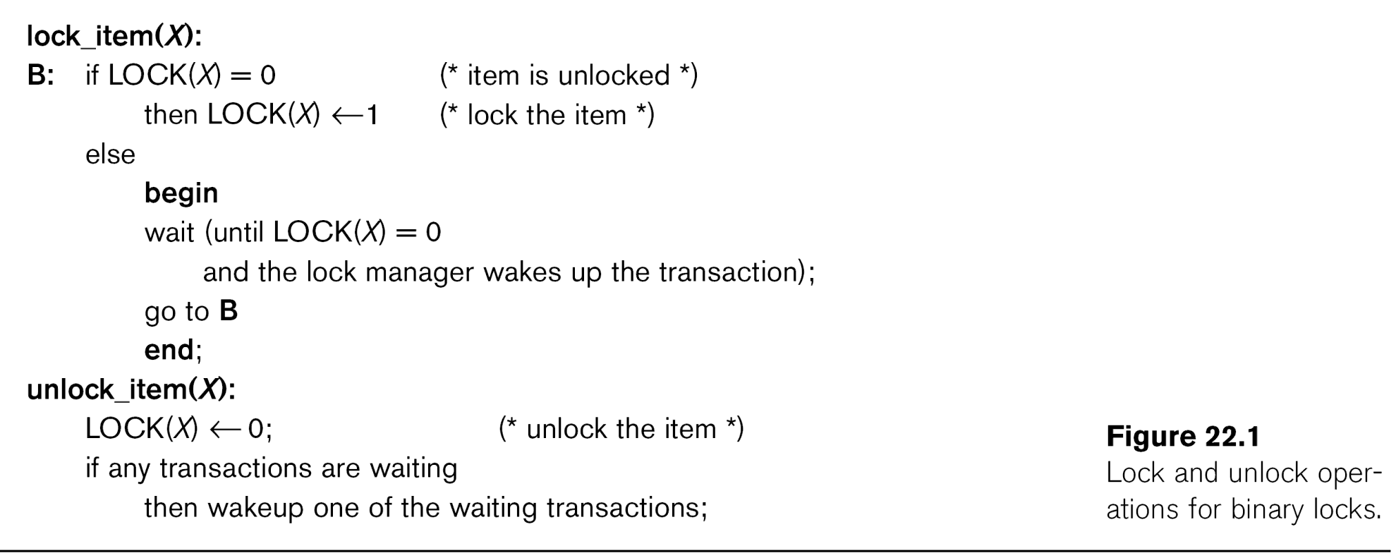

Slide 70
2PL Concurrency Control (cont.)
Locking for database items:
For database purposes, binary locks are not sufficient:
Two locks modes are needed (a) shared lock (read lock) and (b) exclusive lock (write lock).
Shared mode: Read lock (X). Several transactions can hold shared lock on X (because read operations are not conflicting).
Exclusive mode: Write lock (X). Only one write lock on X can exist at any time on an item X. (No read or write locks on X by other transactions can exist).
Conflict matrix

Slide 71
2PL Concurrency Control (cont.)
Three operations are now needed:
read_lock(X): transaction T requests a read (shared) lock on item X
write_lock(X): transaction T requests a write (exclusive) lock on item X
unlock(X): transaction T unlocks an item that it holds a lock on (shared or exclusive)
Transaction can be blocked (forced to wait) if the item is held by other transactions in conflicting lock mode
Conflicts are write-write or read-write (read-read is not conflicting)
Next slide gives outline of these three operations

Slide 73
2PL Concurrency Control (cont.)
Two-Phase Locking Techniques: Essential components
Lock Manager: Subsystem of DBMS that manages locks on data items.
Lock table: Lock manager uses it to store information about locked data items, such as: data item id, transaction id, lock mode, list of waiting transaction ids, etc. One simple way to implement a lock table is through linked list (shown). Alternatively, a hash table with item id as hash key can be used.

Slide 74
2PL Concurrency Control (cont.)
Rules for locking:
Transaction must request appropriate lock on a data item X before it reads or writes X.
If T holds a write (exclusive) lock on X, it can both read and write X.
If T holds a read lock on X, it can only read X.
T must unlock all items that it holds before terminating
(also T cannot unlock X unless it holds a lock on X).

Slide 75
2PL Concurrency Control (cont.)
Lock conversion
Lock upgrade: existing read lock to write lock
if Ti holds a read-lock on X, and no other Tj holds a read-lock on X (i ≠ j), then
it is possible to convert (upgrade) read-lock(X) to write-lock(X)
else
force Ti to wait until all other transactions Tj that hold read locks on X release their locks
Lock downgrade: existing write lock to read lock
if Ti holds a write-lock on X
(*this implies that no other transaction can have any lock on X*)
then it is possible to convert (downgrade) write-lock(X) to read-lock(X)

Slide 76
2PL Concurrency Control (cont.)
Two-Phase Locking Rule:
Each transaction should have two phases: (a) Locking (Growing) phase, and (b) Unlocking (Shrinking) Phase.
Locking (Growing) Phase: A transaction applies locks (read or write) on desired data items one at a time. Can also try to upgrade a lock.
Unlocking (Shrinking) Phase: A transaction unlocks its locked data items one at a time. Can also downgrade a lock.
Requirement: For a transaction these two phases must be mutually exclusively, that is, during locking phase no unlocking or downgrading of locks can occur, and during unlocking phase no new locking or upgrading operations are allowed.

Slide 77
2PL Concurrency Control (cont.)
Basic Two-Phase Locking:
When transaction starts executing, it is in the locking phase, and it can request locks on new items or upgrade locks. A transaction may be blocked (forced to wait) if a lock request is not granted. (This may lead to several transactions being in a state of deadlock – see later)
Once the transaction unlocks an item (or downgrades a lock), it starts its shrinking phase and can no longer upgrade locks or request new locks.
The combination of locking rules and 2-phase rule ensures serializable schedules

Slide 78
2PL Concurrency Control (cont.)
Some Examples:
Rules of locking alone do not enforce serializability – Figure 22.3(c) shows a schedule that follows locking rules but is not serializable
Figure 22.4 shows how the transactions in Figure 22.3(a) can be modified to follow the two-phase rule (by delaying the first unlock operation till all locking is completed).
The schedule in 22.3(c) would not be allowed if the transactions are changed as in 22.4 – a state of deadlock would occur instead because T2 would try to lock Y (which is locked by T1 in conflicting mode) and forced to wait, then T1 would try to lock X (which is locked by T2 in conflicting mode) and forced to wait – neither transaction can continue to unlock the item they hold as they are both blocked (waiting) – see Figure 22.5

Slide 80
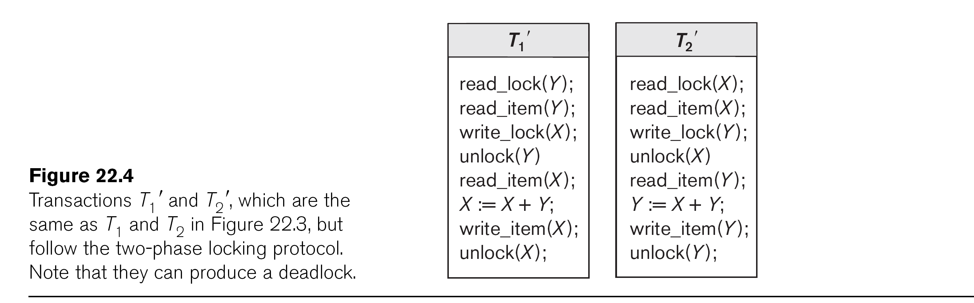

Slide 81
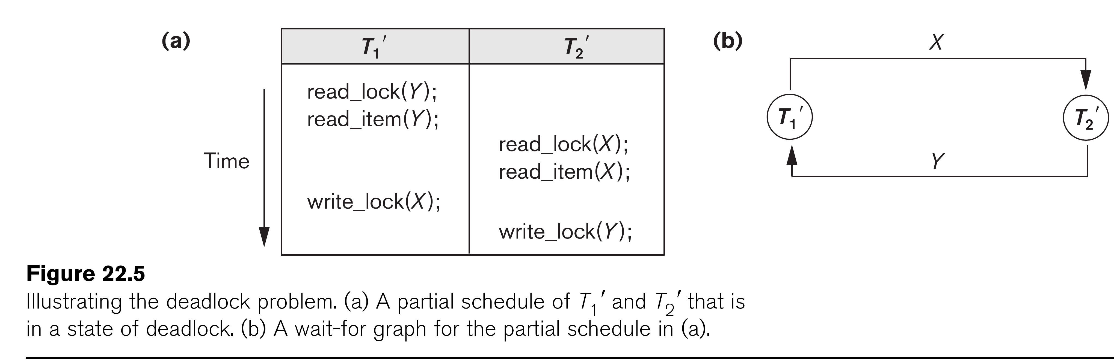

Slide 82
2PL Concurrency Control (cont.)
Other Variations of Two-Phase Locking:
Conservative 2PL: A transaction must lock all its items before starting execution. If any item it needs is not available, it locks no items and tries again later. Conservative 2PL has no deadlocks since no lock requests are issued once transaction execution starts.
Strict 2PL: All items that are writelocked by a transaction are not released (unlocked) until after the transaction commits. This is the most commonly used two-phase locking algorithm, and ensures strict schedules (for recoverability).
Rigorous 2PL: All items that are writelocked or readlocked by a transaction are not released (unlocked) until after the transaction commits. Also guarantees strict schedules.

Slide 83
2PL Concurrency Control (cont.)
Deadlock Example (see Figure 22.5)
T1' T2'
read_lock (Y); T1' and T2' did follow two-phase
read_item (Y); policy but they are deadlock
read_lock (X);
read_item (Y);
write_lock (X);
(waits for X) write_lock (Y);
(waits for Y)
Deadlock (T1' and T2')

Slide 84
2PL Concurrency Control (cont.)
Dealing with Deadlock
Deadlock prevention
System enforces additional rules (deadlock prevention protocol) to ensure deadlock do not occur – many protocols (see later for some examples)
Deadlock detection and resolution
System checks for a state of deadlock – if a deadlock exists, one of the transactions involved in the deadlock is aborted

Slide 85
2PL Concurrency Control (cont.)
1. Deadlock detection and resolution
In this approach, deadlocks are allowed to happen. The system maintains a wait-for graph for detecting cycles. If a cycle exists, then one transaction involved in the cycle is selected (victim) and rolled-back (aborted).
A wait-for graph contains a node for each transaction. When a transaction (say Ti) is blocked because it requests an item X held by another transaction Tj in conflicting mode, a directed edge is created from Ti to Tj (Ti is waiting on Tj to unlock the item). The system checks for cycles; if a cycle exists, a state of deadlock is detected (see Figure 22.5).

Slide 86
2PL Concurrency Control (cont.)
2. Deadlock prevention
There are several protocols. Some of them are:
1. Conservative 2PL, as we discussed earlier.
2. No-waiting protocol: A transaction never waits; if Ti requests an item that is held by Tj in conflicting mode, Ti is aborted. Can result in needless transaction aborts because deadlock might have never occurred
3. Cautious waiting protocol: If Ti requests an item that is held by Tj in conflicting mode, the system checks the status of Tj; if Tj is not blocked, then Ti waits – if Tj is blocked, then Ti aborts. Reduces the number of needlessly aborted transactions

Slide 87
2PL Concurrency Control (cont.)
2. Deadlock prevention (cont.)
4. Wound-wait and wait-die: Both use transaction timestamp TS(T), which is a monotonically increasing unique id given to each transaction based on their starting time
TS(T1) < TS(T2) means that T1 started before T2 (T1 older than T2)
(Can also say T2 younger than T1)
Wait-die:
If Ti requests an item X that is held by Tj in conflicting mode, then
if TS(Ti) < TS(Tj) then Ti waits (on a younger transaction Tj)
else Ti dies (if Ti is younger than Tj, it aborts)
[In wait-die, transactions only wait on younger transactions that started later, so no cycle ever occurs in wait-for graph – if transaction requesting lock is younger than that holding the lock, requesting transaction aborts (dies)]

Slide 88
2PL Concurrency Control (cont.)
2. Deadlock prevention (cont.)
4. Wound-wait and wait-die (cont.):
Wound-wait:
If Ti requests an item X that is held by Tj in conflicting mode, then
if TS(Ti) < TS(Tj) then Tj is aborted (Ti wounds younger Tj)
else Ti waits (on an older transaction Tj)
[In wound-wait, transactions only wait on older transactions that started earlier, so no cycle ever occurs in wait-for graph – if transaction requesting lock is older than that holding the lock, transaction holding the lock is preemptively aborted]

Slide 89
Database Concurrency Control
Dealing With Starvation
Starvation occurs when a particular transaction consistently waits or gets restarted and never gets a chance to proceed further. Solution is to use a fair priority-based scheme that increases the priority for transaction the longer they wait.
Examples of Starvation:
1. In deadlock detection/resolution it is possible that the same transaction may consistently be selected as victim and rolled-back.
2. In conservative 2PL, a transaction may never get started because all the items needed are never available at the same time.
3. In Wound-Wait scheme a younger transaction may always be wounded (aborted) by a long running older transaction which may create starvation.

Slide 90
Other Concurrency Control Methods
Some CCMs other than 2PL:
Timestamp Ordering (TO) CCM
Optimistic (Validation-Based) CCMs
Multi-version CCMs:
Multiversion 2PL with Certify Locks
Multiversion TO

Slide 91
Timestamp Ordering (TO) CCM
Timestamp
A monotonically increasing identifier (e.g., an integer, or the system clock time when a transaction starts) indicating the start order of a transaction. A larger timestamp value indicates a more recently started transaction.
Timestamp of transaction T is denoted by TS(T)
Timestamp ordering CCM uses the transaction timestamps to serialize the execution of concurrent transactions – allows only one equivalent serial order based on the transaction timestamps

Slide 92
Timestamp Ordering (TO) CCM (cont.)
Instead of locks, systems keeps track of two values for each data item X:
Read_TS(X): The largest timestamp among all the timestamps of transactions that have successfully read item X
Write_TS(X): The largest timestamp among all the timestamps of transactions that have successfully written X
When a transaction T requests to read or write an item X, TS(T) is compared with read_TS(X) and write_TS(X) to determine if request is out-of-order

Slide 93
Timestamp Ordering (TO) CCM (cont.)
Basic Timestamp Ordering
1. Transaction T requests a write_item(X) operation:
If read_TS(X) > TS(T) or if write_TS(X) > TS(T), then a younger transaction has already read or written the data item so abort and roll-back T and reject the operation.
Otherwise, execute write_item(X) of T and set write_TS(X) to TS(T).
2. Transaction T requests a read_item(X) operation:
If write_TS(X) > TS(T), then a younger transaction has already written the data item X so abort and roll-back T and reject the operation.
Otherwise, execute read_item(X) of T and set read_TS(X) to the larger of TS(T) and the current read_TS(X).

Slide 94
Purpose of Database Recovery
To bring the database into a consistent state after a failure occurs.
To ensure the transaction properties of Atomicity (a transaction must be done in its entirety; otherwise, it has to be rolled back) and Durability (a committed transaction cannot be canceled and all its updates must be applied permanently to the database).
After a failure, the DBMS recovery manager is responsible for bringing the system into a consistent state before transactions can resume.

Slide 95
Types of Failure
Transaction failure: Transactions may fail because of errors, incorrect input, deadlock, incorrect synchronization, etc.
System failure: System may fail because of application error, operating system fault, RAM failure, etc.
Media failure: Disk head crash, power disruption, etc.

Slide 96
The Log File
Holds the information that is necessary for the recovery process
Records all relevant operations in the order in which they occur (looks like a schedule of transactions, see Chapter 21)
Is an append-only file.
Holds various types of log records (or log entries).

Slide 97
Log File Entries (from Chapter 21)
Types of records (entries) in log file:
[start_transaction,T]: Records that transaction T has started execution.
[write_item,T,X,old_value,new_value]: T has changed the value of item X from old_value to new_value.
[read_item,T,X]: T has read the value of item X (not needed in many cases).
[end_transaction,T]: T has ended execution
[commit,T]: T has completed successfully, and committed.
[abort,T]: T has been aborted.

Slide 98
The Log File (cont.)
For write_item log entry, old value of item before modification (BFIM - BeFore Image) and the new value after modification (AFIM – AFter Image) are stored. BFIM needed for UNDO, AFIM needed for REDO. A sample log is given below. Back P and Next P point to the previous and next log records of the same transaction.

Slide 99
Database Cache
Database Cache: A set of main memory buffers; each buffer typically holds contents of one disk block. Stores the disk blocks that contain the data items being read and written by the database transactions.
Data Item Address: (disk block address, offset, size in bytes).
Cache Table:Table of entries of the form (buffer addr, disk block addr, modified bit, pin/unpin bit, ...) to indicate which disk blocks are currently in the cache buffers.

Slide 100
Database Cache (cont.)
Data items to be modified are first copied into database cache by the Cache Manager (CM) and after modification they are flushed (written) back to the disk. The flushing is controlled by Modified and Pin-Unpin bits.
Pin-Unpin: If a buffer is pinned, it cannot be written back to disk until it is unpinned.
Modified: Indicates that one or more data items in the buffer have been changed.

Slide 101
Data Update
Immediate Update: A data item modified in cache can be written back to disk before the transaction commits.
Deferred Update: A modified data item in the cache cannot be written back to disk till after the transaction commits (buffer is pinned).
Shadow update: The modified version of a data item does not overwrite its disk copy but is written at a separate disk location (new version).
In-place update: The disk version of the data item is overwritten by the cache version.

Slide 102
UNDO and REDO Recovery Actions
To maintain atomicity and durability, some transaction’s may have their operations redone or undone during recovery. UNDO (roll-back) is needed for transactions that are not committed yet. REDO (roll-forward) is needed for committed transactions whose writes may have not yet been flushed from cache to disk.
Undo: Restore all BFIMs from log to database on disk. UNDO proceeds backward in log (from most recent to oldest UNDO).
Redo: Restore all AFIMs from log to database on disk. REDO proceeds forward in log (from oldest to most recent REDO).

Slide 103
Write-ahead Logging Protocol
The information needed for recovery must be written to the log file on disk before changes are made to the database on disk. Write-Ahead Logging (WAL) protocol consists of two rules:
For Undo: Before a data item’s AFIM is flushed to the database on disk (overwriting the BFIM) its BFIM must be written to the log and the log must be saved to disk.
For Redo: Before a transaction executes its commit operation, all its AFIMs must be written to the log and the log must be saved on a stable store.

Slide 104
Checkpointing
To minimize the REDO operations during recovery. The following steps define a checkpoint operation:
Suspend execution of transactions temporarily.
Force write modified buffers from cache to disk.
Write a [checkpoint] record to the log, save the log to disk. This record also includes other info., such as the list of active transactions at the time of checkpoint.
Resume normal transaction execution.
During recovery redo is required only for transactions that have committed after the last [checkpoint] record in the log.

Slide 105
Checkpointing (cont.)
Steps 1 and 4 in previous slide are not realistic.
A variation of checkpointing called fuzzy checkpointing allows transactions to continue execution during the checkpointing process.
We discuss fuzzy checkpointing in the ARIES protocol later.

Slide 106
Other Database Recovery Concepts
Steal/No-Steal and Force/No-Force
Specify how to flush database cache buffers to database on disk:
Steal: Cache buffers updated by a transaction may be flushed to disk before the transaction commits (recovery may require UNDO).
No-Steal: Cache buffers cannot be flushed until after transaction commit (NO-UNDO). (Buffers are pinned till transactions commit).
Force: Cache is flushed (forced) to disk before transaction commits (NO-REDO).
No-Force: Some cache flushing may be deferred till after transaction commits (recovery may require REDO).
These give rise to four different ways for handling recovery:
Steal/No-Force (Undo/Redo), Steal/Force (Undo/No-redo), No-Steal/No-Force (Redo/No-undo), No-Steal/Force (No-undo/No-redo).

Slide 107
Deferred Update (NO-UNDO/REDO) Recovery Protocol
System must impose NO-STEAL rule. Recovery subsystem analyzes the log, and creates two lists:
Active Transaction list: All active (uncommitted) transaction ids are entered in this list.
Committed Transaction list: Transactions committed after the last checkpoint are entered in this table.
During recovery, transactions in commit list are redone; transactions in active list are ignored (because of NO-STEAL rule, none of their writes have been applied to the database on disk). Some transactions may be redone twice; this does not create inconsistency because REDO is “idempotent”, that is, one REDO for an AFIM is equivalent to multiple REDO for the same AFIM.

Slide 108
Deferred Update (NO-UNDO/REDO) Recovery Protocol (cont.)
Advantage: Only REDO is needed during recovery.
Disadvantage: Many buffers may be pinned while waiting for transactions that updated them to commit, so system may run out of cache buffers when requests are made by new transactions.

Slide 109
UNDO/NO-REDO Recovery Protocol
In this method, FORCE rule is imposed by system (AFIMs of a transaction are flushed to the database on disk under Write Ahead Logging before the transaction commits).
Transactions in active list are undone; transactions in committed list are ignored (because based on FORCE rule, all their changes are already written to the database on disk).
Advantage: During recovery, only UNDO is needed.
Disadvantages: 1. Commit of a transaction is delayed until all its changes are force-written to disk. 2. Some buffers may be written to disk multiple times if they are updated by several transactions.

Slide 110
UNDO/REDO Recovery Protocol
Recovery can require both UNDO of some transactions and REDO of other transactions (Corresponds to STEAL/NO-FORCE). Used most often in practice because of disadvantages of the other two methods. To minimize REDO, checkpointing is used. The recovery performs:
Undo of a transaction if it is in the active transaction list.
Redo of a transaction if it is in the list of transactions that committed since the last checkpoint.

Slide 111
Shadow Paging (NO-UNDO/NO-REDO)
The AFIM does not overwrite its BFIM but is recorded at another place (new version) on the disk. Thus, a data item can have AFIM and BFIM (Shadow copy of the data item) at two different places on the disk.
X and Y: Shadow (old) copies of data items
X` and Y`: Current (new) copies of data items

Slide 113
ARIES Database Recovery
Used in practice, it is based on:
WAL (Write Ahead Logging)
Repeating history during redo: ARIES will retrace all actions of the database system prior to the crash to reconstruct the correct database state.
Logging changes during undo: It will prevent ARIES from repeating the completed undo operations if a failure occurs during recovery, which causes a restart of the recovery process.

Slide 114
ARIES Database Recovery (cont.)
The ARIES recovery algorithm consists of three steps:
Analysis: step identifies the dirty (updated) page buffers in the cache and the set of transactions active at the time of crash. The set of transactions that committed after the last checkpoint is determined, and the appropriate point in the log where redo is to start is also determined.
Redo: necessary redo operations are applied.
Undo: log is scanned backwards and the operations of transactions active at the time of crash are undone in reverse order.

Slide 115
ARIES Database Recovery (cont.)
The Log and Log Sequence Number (LSN)
A log record is written for (a) data update (Write), (b) transaction commit, (c) transaction abort, (d) undo, and (e) transaction end. In the case of undo a compensating log record is written.
A unique LSN is associated with every log record. LSN increases monotonically and indicates the disk address of the log record it is associated with. In addition, each data page stores the LSN of the latest log record corresponding to a change for that page.

Slide 116
ARIES Database Recovery (cont.)
The Log and Log Sequence Number (LSN) (cont.)
A log record stores:
LSN of previous log record for same transaction: It links the log records of each transaction.
Transaction ID.
Type of log record.
For a write operation, additional information is logged:
Page ID for the page that includes the item
Length of the updated item
Its offset from the beginning of the page
BFIM of the item
AFIM of the item

Slide 117
ARIES Database Recovery (cont.)
The Transaction table and the Dirty Page table
For efficient recovery, the following tables are also stored in the log during checkpointing:
Transaction table: Contains an entry for each active transaction, with information such as transaction ID, transaction status, and the LSN of the most recent log record for the transaction.
Dirty Page table: Contains an entry for each dirty page (buffer) in the cache, which includes the page ID and the LSN corresponding to the earliest update to that page.

Slide 118
ARIES Database Recovery (cont.)
“Fuzzy” Checkpointing
A checkpointing process does the following:
Writes a begin_checkpoint record in the log, then forces updated (dirty) buffers to disk.
Writes an end_checkpoint record in the log, along with the contents of transaction table and dirty page table.
Writes the LSN of the begin_checkpoint record to a special file. This special file is accessed during recovery to locate the last checkpoint information.
To allow the system to continue to execute transactions, ARIES uses “fuzzy checkpointing”.

Slide 119
ARIES Database Recovery (cont.)
The following steps are performed for recovery
Analysis phase: Start at the begin_checkpoint record and proceed to the end_checkpoint record. Access transaction table and dirty page table that were appended to the log. During this phase some other records may be written to the log and the transaction table may be modified. The analysis phase compiles the set of redo and undo operations to be performed and ends.
Redo phase: Starts from the point in the log where all dirty pages have been flushed, and move forward. Operations of committed transactions are redone.
Undo phase: Starts from the end of the log and proceeds backward while performing appropriate undo. For each undo it writes a compensating record in the log.
The recovery completes at the end of undo phase.

Slide 121
Recovery in Multi-database Transactions (Two-phase commit)
A multidatabase transaction can access several databases: e.g. airline database, car rental database, credit card database. The transaction commits only when all these multiple databases agree to commit individually the part of the transaction they were executing. This commit scheme is referred to as “two-phase commit” (2PC). If any one of these nodes fails or cannot commit its part of the transaction, then the whole transaction is aborted. Each node recovers the transaction under its own recovery protocol.

Slide 122
Two-phase commit (cont.)
Phase 1: Coordinator (usually application program running in middle-tier of 3-tier architecture) sends “Ready-to-commit?” query to each participating database, then waits for replies. A participating database replies Ready-to-commit only after saving all actions in its local log on disk.
Phase 2: If coordinator receives Ready-to-commit signals from all participating databases, it sends Commit to all; otherwise, it send Abort to all.
This protocol can survive most types of crashes.

Slide 123
Questions
Explain the properties of transactions.
What is serializability? Explain.
What is 2PL? Explain.
Explain shadow paging.
Explain ARIES recovery algorithm.

